Slide 1
Class (Chapter 5)
Describe concepts of class, class object
Define a Java class, its methods

Slide 2
Class and Method Definitions
Student
Course
Java program consists of objects
    Objects of class types
    Objects that interact with one another
Program objects can represent
    Objects in real world
    Abstractions
Professor
Department
School

Slide 3
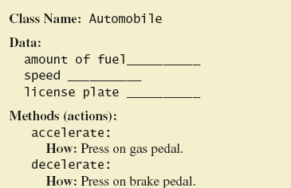
Class and Method Definitions

Slide 4
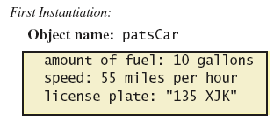
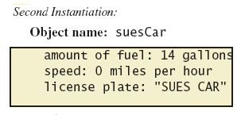
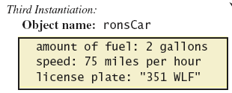
Class and Method Definitions
Objects that are instantiations of the class Automobile

Slide 5
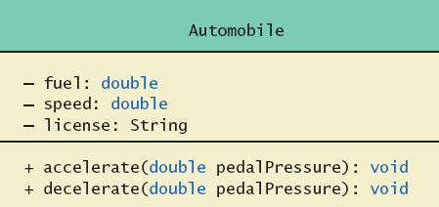
Class and Method Definitions
A class outline as a UML (Universal Modeling Language) class diagram

Slide 6
Class Files and Separate Compilation
Each Java class definition usually in a file by itself
    File begins with name of the class
    Ends with .java
Class can be compiled separately
Helpful to keep all class files used by a program in the same directory

Slide 7
Class – example
Each class consists of instance variables and methods
public class Dog {
public String name;
public String breed;
public int age;
public void writeOutput() {
System.out.println(“Name: ” + name);
System.out.println(“Breed: ” + breed);
System.out.println(“Age in calendar years : ” + age);
System.out.println(“Age in human years : ” + getAgeInHumanYears());
}
public int getAgeInHumanYears() {
int humanAge = 0;
if ( age <= 2 ) humanAge = age * 11;
else humanAge = 22 + ((age-2) + 5);
return humanAge;
}
}
  Each class can be public or not.
Instance variables
  Each field and method can be public, private, or protected.
Methods

Slide 8
Class – example using the defined class
public class DogDemo {
public static void main(String[] args)
{
Dog balto = new Dog();
balto.name = “Balto”;
balto.age = 8;
balto.breed = “Siberian Husky”;
balto.writeOutput();
}
}
Object creation
Calling a method

Slide 9
Class – summary
A class consists of instance variables (fields) and methods(functions)
“new” is a unary operator to create objects of a class
All the methods should be implemented within the class

Slide 10
Methods
Calling a method that returns a single value or object
    Use anywhere a value can be used
Calling a void method
    Resulting statement performs the action defined by the method

Slide 11
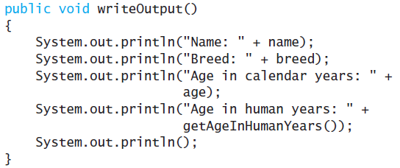
Defining void Methods
Consider method writeOutput from the example
Method definitions appear inside class definition
    Can be used only with objects of that class

Slide 12
Defining void Methods
Most method definitions we will see as public
Method does not return a value
    Specified as a void method
Heading includes parameters
Body enclosed in braces { }
Think of method as defining an action to be taken

Slide 13
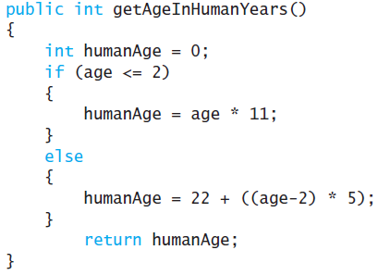
Methods That Return a Value
Consider method getAgeInHumanYears( )
Heading declares type of value to be returned
Last statement executed is return

Slide 14
The Keyword this
Referring a name for the object receiving the method call
public void writeOutput() {
System.out.println(“Name: ” + name);
System.out.println(“Breed: ” + breed);
System.out.println(“Age in calendar years : ” + age);
}
public void writeOutput() {
System.out.println(“Name: ” + this.name);
System.out.println(“Breed: ” + this.breed);
System.out.println(“Age in calendar years : ” + this.age);
}

Slide 15
The Keyword this
Inside the class the unnamed object can be referred to with the name this
Example
this.name = keyboard.nextLine();
The keyword this stands for the receiving object
We will see some situations later that require the this

Slide 16
Local Variables
Variables declared inside a method are called local variables
    May be used only inside the method
    All variables declared in method main are local to main
Local variables having the same name and declared in different methods are different variables

Slide 17
Local Variables – example
public class BankAccount {
int newAmount = 0;
}
public class LocalVariablesDemoProgram {
int newAmount = 0;
}
Two different variables newAmount

Slide 18
Blocks
Recall compound statements
    Enclosed in braces { }
When you declare a variable within a compound statement
    The compound statement is called a block
    The scope of the variable is from its declaration to the end of the block
Variable declared outside the block usable both outside and inside the block

Slide 19
Parameters of Primitive Type
Note the declaration
public int predictPopulation(int years)
    The formal parameter is years
Calling the method
int futurePopulation =
speciesOfTheMonth.predictPopulation(10);
    The actual parameter is the integer 10

Slide 20
Parameters of Primitive Type
Parameter names are local to the method
When method invoked
    Each parameter initialized to value in corresponding actual parameter
    Primitive actual parameter cannot be altered by invocation of the method
Automatic type conversion performed
byte -> short -> int ->
long -> float -> double

Slide 21
Exercise
Define class “Species” with instance variables name (String), population (int), and growthRate (double)
Write three methods as follows
    public void readInput(): input the values for three variables from the keyboard
    public void writeOutput(): output three values
    public int getPopulationIn(int years): return the projected population of the receiving object after the specified number of years

Slide 22
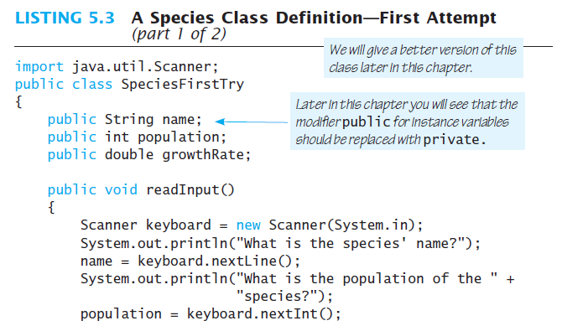
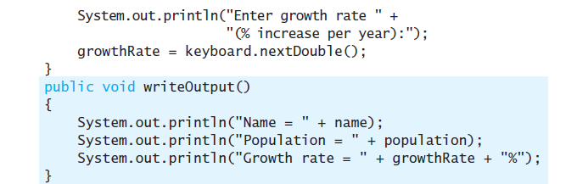
Exercise – code example

Slide 23
